Slide 1
Kidney stone detection using DIP
AKSHAY P BHAGWAT 1BI20CS017
BENAKA ADITYA 1BI20CS039
ARYAMAN JALALI 1BI20CS032
AAYUSH 1BI20CS002

Slide 2
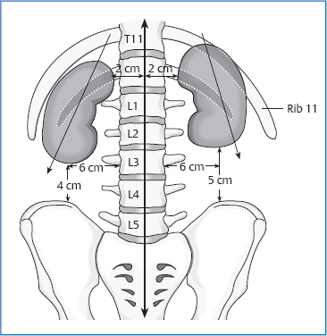
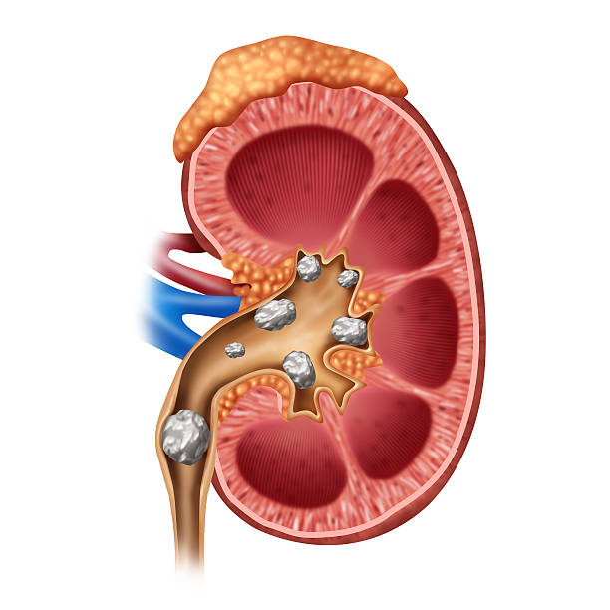
Biology and anatomy of kidney
Where is kidney in the body?
Between 12th thoracic and 3rd lumbar vertibrae

Slide 3
Biology and anatomy of kidney
Function of kidney?
Filtering blood, excreting toxins, minerals & vitamins.
Electrolyte balance, Ph balance, blood pressure
What causes kidney stones? And density of kidney stones

Slide 4
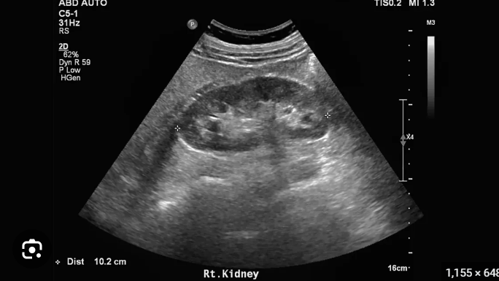
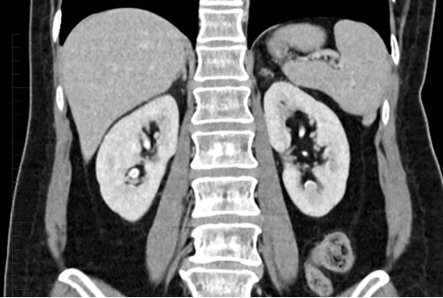
Methods for detecting kidney stones
Lab tests
Urinalysis
Blood tests.
Imaging tests
Abdominal x-ray
Computed tomography (CT) scans
Abdominal ultrasound

Slide 5
Image Processing
Image processing is the process of transforming an image into a digital form and performing certain operations to get some useful information from it.
The image processing system usually treats all images as 2D signals when applying certain predetermined signal processing methods.
OpenCV is a huge open-source library for computer vision, machine learning, and image processing
OpenCV supports a wide variety of programming languages like Python, C++, Java, etc. It can process images and videos to identify objects, faces, or even the handwriting of a human.

Slide 6
Libraries used
import NumPy (Numerical Python)= is a popular library in Python for scientific computing and working with arrays and numerical operations. It provides efficient and convenient functions for performing mathematical and logical operations on arrays of data.
import cv2=This allows you to perform various computer vision tasks such as image and video processing, object detection and tracking, feature extraction, camera calibration, and much more.
import tensorflow =TensorFlow provides a flexible and efficient framework for building and training machine learning models, particularly deep neural networks.
import glob=The main purpose of the glob module is to simplify working with file and directory paths by allowing you to use wildcards and pattern matching.

Slide 7
Libraries used(2)
import skimage =Scikit-image is built on top of NumPy, another popular library for numerical computations in Python it provides a collection of algorithms and functions for image manipulation, analysis, and computer vision tasks.
import warning= used in Python to import the warnings module. The warnings module is a part of the Python standard library and provides functions and classes for issuing and controlling warning messages.
import pandas = It is used in Python to import the pandas library. Pandas is a powerful open-source data manipulation and analysis library that provides easy-to-use data structures and data analysis tools for Python.
import natsort= It is used in Python to import the natsort module. The natsort module is a third-party library that provides natural sorting algorithms for ordering strings that contain numeric values.

Slide 8
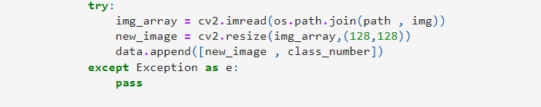
img_array = cv2.imread(os.path.join(path, img))= This line reads the image file using the cv2.imread() function. It takes the path to the image file as an argument, which is created by joining the path and the current img file name using os.path.join() function. The resulting image data is stored in the img_array variable.
new_image = cv2.resize(img_array, (128, 128))= This line resizes the image to a desired size of 128x128 pixels using the cv2.resize() function. It takes the img_array as input and returns a new image with the specified dimensions, which is then stored in the new_image variable
data.append([new_image, class_number])= This line appends the resized image (new_image) and the corresponding class_number to a data list. It assumes that class_number holds some label or identifier associated with the image.

Slide 9
Image preprocessing
Need for Preprocessing
Noise reduction
Contrast enhancement
Image smoothening
Image resizing and scaling
Image rotation and alignment
Image normalization
Notes:
Nedd for preprocessing:
Noise reduction
Contrast enhancement
Image smoothing
Image resizing and scaling
Image rotation and alignment
Image normalization

Slide 10
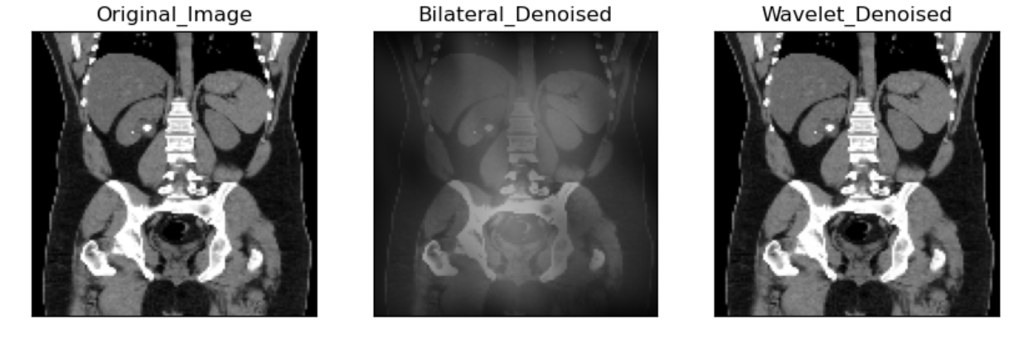
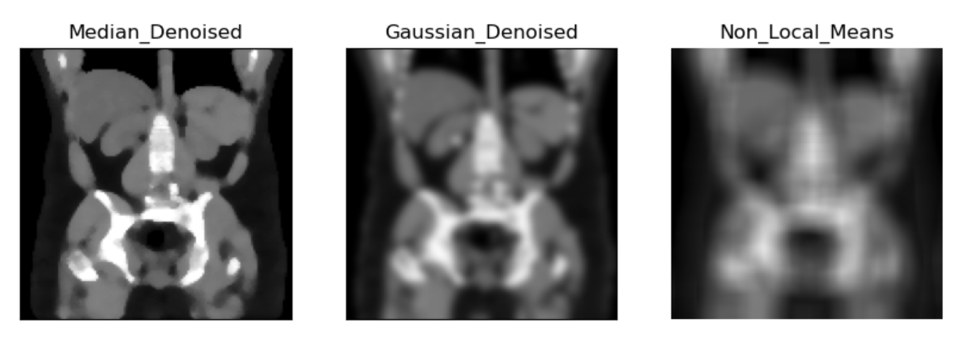
Preprocessing techniques for images:
Notes:
Techniwues
How to choose which one?
Trade off

Slide 11
Median Filtering def median_wholedataset(noised_dataset, filtersize, size): Gaussian Filtering def GaussianFilter_wholedataset(noised_dataset, sigma): Bilateral Filtering def BilateralFilter_wholedataset(noised_dataset, sigma_color, sigma_spatial, channel_axis, size):
Notes:
Median Filtering: Salt-and-pepper noise, spiky noise, preserving edges.
Gaussian Filtering: Smoothing, Gaussian noise, blurring.
Bilateral Filtering: Smoothing, preserving edges, fine details, spatial proximity, intensity similarity.

Slide 12
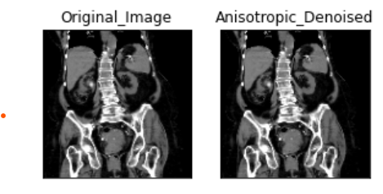
Anisotropic Filtering def AnisotropicFilter_wholedataset(noised_dataset, niter, kappa, gamma, option, size): Wavelet Denoising def wavelet_wholedataset(noised_dataset, sigma, wavelet_levels, size): Non-local Means Denoising def non_local_mean(image): OpenCV Bilateral Filter def cv2bilateralFilter(image, d, sigmaColor, sigmaSpace):
Notes:
Anisotropic Filtering: Medical images, microscopic images, preserving edges, specific applications.
Wavelet Denoising: Various types of images, wavelet transforms, frequency bands, image details.
Non-local Means Denoising: Textures, structures, redundancy, image content.
OpenCV Bilateral Filter: Smoothing, preserving edges, fine details, OpenCV library.

Slide 13
Metrics to check preprocessing efficiency:
SSID
measures the sum of squared differences between pixel intensities in two images.
MSE
measures the average of squared differences between pixel intensities in two images.
PSNR
measures the ratio of peak signal power to the noise power in an image.
Notes:
SSID (Sum of Squared Intensity Differences) is a metric used to evaluate the similarity or dissimilarity between two images. A lower SSID value indicates a higher similarity between the images.
MSE (Mean Squared Error) is another commonly used metric for image quality assessment. Similar to SSID, a lower MSE value indicates a higher similarity between the images.
Peak Signal-to-Noise Ratio (PSNR) is a metric used to quantify the quality of an image reconstruction or denoising process. It measures the ratio of the peak signal power to the noise power in an image. PSNR is often expressed in decibels (dB), and a higher PSNR value indicates a higher quality image.

Slide 14
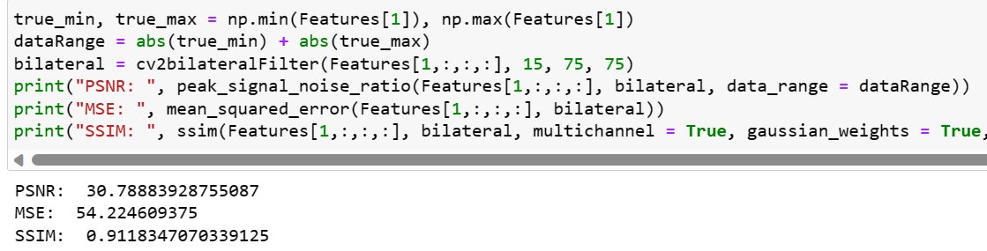
Notes:
SSID (Sum of Squared Intensity Differences) is a metric used to evaluate the similarity or dissimilarity between two images. A lower SSID value indicates a higher similarity between the images.
MSE (Mean Squared Error) is another commonly used metric for image quality assessment. Similar to SSID, a lower MSE value indicates a higher similarity between the images.
Peak Signal-to-Noise Ratio (PSNR) is a metric used to quantify the quality of an image reconstruction or denoising process. It measures the ratio of the peak signal power to the noise power in an image. PSNR is often expressed in decibels (dB), and a higher PSNR value indicates a higher quality image.

Slide 15
Steps we analysed:
Preprocessing
Segmentation
Feature extraction
Classification
Detection
Notes:
Preprocessing: Image preprocessing techniques such as noise reduction, image enhancement, and normalization can improve the quality and clarity of kidney stone images, making them easier to analyze.
Segmentation: Techniques like thresholding, region growing, or active contour models can be applied to segment kidney stones effectively.
Feature Extraction: Extracting relevant features from the segmented kidney stone regions can aid in characterization and classification. Features such as shape, texture, intensity, and size can provide valuable information for differentiating types of kidney stones.
Classification: Machine learning and pattern recognition algorithms can be employed to classify kidney stones based on their features
Detection and Localization: Once the kidney stones are segmented and classified, the precise detection and localization of stones within the kidney or urinary tract can be performed.

Slide 16
Analysis
Analysis include
Cropping
Edge detection
Threshold masking

Slide 17
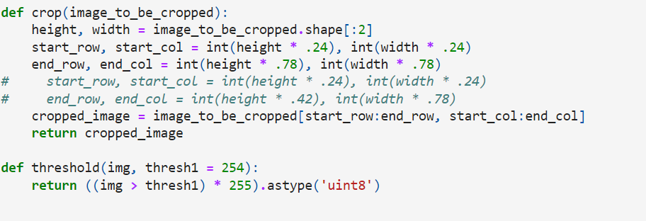
Cropping
This function takes an image as input and returns a cropped version of that image.
The purpose of this code is to crop the input image, specifically selecting a region of interest within the image defined by the percentage values (24% and 78%) of its height and width. By adjusting these percentage values, you can control the size and location of the crop within the image.

Slide 18
Edge detection
The method used for edge detection is the canny edge detection technique.
The Canny algorithm detects edges by looking for intensity gradients within the specified threshold range.
The general criteria for edge detection include:
Detection of edge with low error rate, which means that the detection should accurately catch as many edges shown in the image as possible
The edge point detected from the operator should accurately localize on the center of the edge.
A given edge in the image should only be marked once, and where possible, image noise should not create false edges.

Slide 19

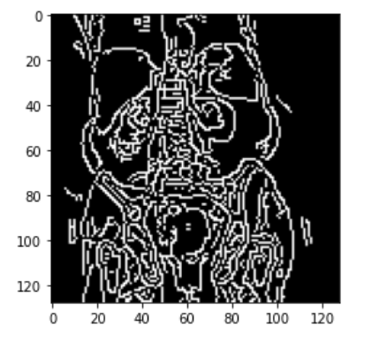
The function takes three arguments : the input image (Image), the lower threshold value for edge detection (100 in this case), and the higher threshold value for edge detection (200 in this case).
Pixels with gradient values below the lower threshold are considered non-edges, while pixels with gradient values above the higher threshold are considered edges.
Pixels with gradient values between the two thresholds are classified as edges if they are connected to pixels above the higher threshold.

Slide 20
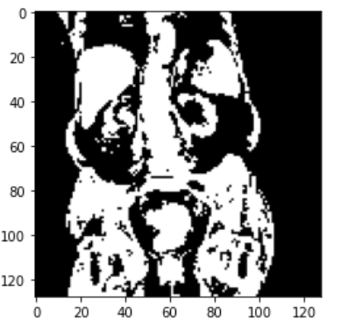
Threshold masking using OSTU method
Thresholding is a technique used to separate regions of an image based on pixel intensity
It converts a grayscale image into a binary image where pixels are either classified as foreground (white) or background (black) based on a specified threshold.
Otsu's method is employed to automatically determine an optimal threshold value based on the image's histogram.

Slide 21
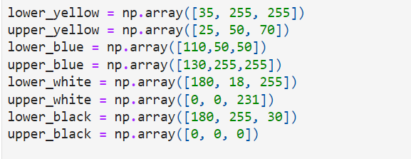
Mask of an image
HSV or Hue Saturation Value is used to separate image luminance from color information.
Hue, in the context of color and graphics, refers to the attribute of a visible light due to which it is differentiated from or similar to the primary colors
It is the attribute that permits colors to be classified as red, yellow, green, blue, or an intermediate color. Saturation pertains the amount of white light mixed with a hue.

Slide 22
Splitting Data:
We usually split the data as:
Training Set and Testing Set
The split is done to evaluate how well the machine learning model can generalize to new and unseen data.

Slide 23
Training set-
The training set is used to train the model. It consists of input samples and their corresponding output labels.
The model learns from the training set by adjusting its internal parameters based on the input-output relationships in the data.

Slide 24
Testing set-
The testing set, on the other hand, is used to evaluate the performance of the trained model.
It consists of input samples that the model has not seen during training.
The model predicts the output labels for these samples, and their predictions are compared against the true labels to assess how well the model generalizes to unseen data.

Slide 25
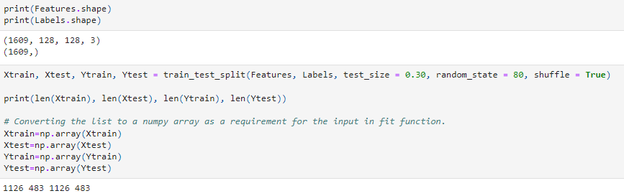
4D-array(1609 samples,128*128 pixels and 3 color channel rgb
Shape of labels 1D array with 1609 samples

Slide 26
CONVOLUTIONAL NEURAL NETWORK(CNN):
A Convolutional Neural Network (CNN) is a deep learning algorithm specifically designed for analyzing visual data such as images and videos.
It is a type of artificial neural network inspired by the organization and functionality of the visual cortex in the human brain.
The key component of a CNN is the convolutional layer. This layer performs a series of convolutions on the input image using a set of learnable filters, also known as kernels.

Slide 27
Each filter detects specific local features, such as edges, corners, or textures, by sliding across the image and computing dot products at each position.
The resulting feature maps preserve spatial relationships and highlight important patterns in the input image.
Typically, a CNN consists of multiple convolutional layers interleaved with activation functions (e.g., ReLU-Rectified Linear Unit), pooling layers (e.g., max pooling), and fully connected layers at the end.
We also use optimization algorithms like Adam(Adaptive Moment Estimation) which helps to provide efficient and adaptive learning rates during the training process.

Slide 28
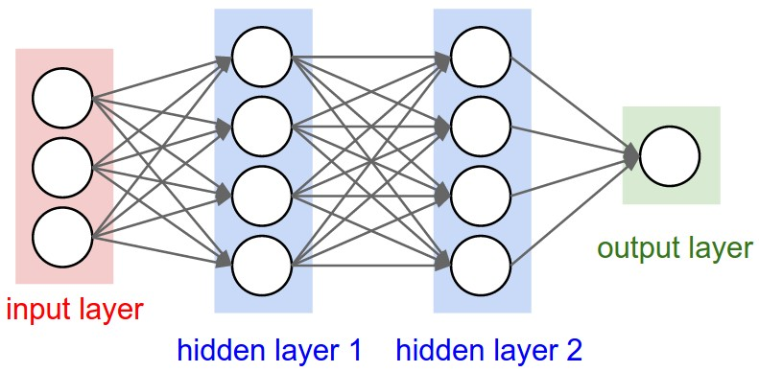

Slide 29
Epoch-
It is used to measure the progress of the training process.
We have a certain way in which we use epoch, which is:
Split your dataset
Define the number of epochs
Training loop
Validation
Repeat until convergence
Test the model

Slide 30
Support Vector Machine (SVM):
A Support Vector Machine (SVM) classifier is a supervised machine learning algorithm used for classification and regression tasks.
It is particularly effective for solving binary classification problems, where the goal is to separate data points into two distinct classes.
SVMs have several advantages, including their ability to handle high-dimensional data, handle nonlinear decision boundaries, and generalize well to unseen data (by using hyperplanes).

Slide 31
Other classifiers are:
Random forest
Naïve Bayes
Decision Trees
Logistic regression
K-Nearest Neighbours

Slide 32
Confusion matrix:
The confusion matrix is a tabular representation that summarizes the performance of a classification model.
It provides valuable insights into the true positive (TP), true negative (TN), false positive (FP), and false negative (FN) predictions made by the model.

Slide 33
True Positives (TP): These are the cases where the model correctly predicted the positive class.
True Negatives (TN): These are the cases where the model correctly predicted the negative class.
False Positives (FP): These are the cases where the model incorrectly predicted the positive class when it should have been negative. This is also known as a Type I error.
False Negatives (FN): These are the cases where the model incorrectly predicted the negative class when it should have been positive. This is known as a Type II error.

Slide 34
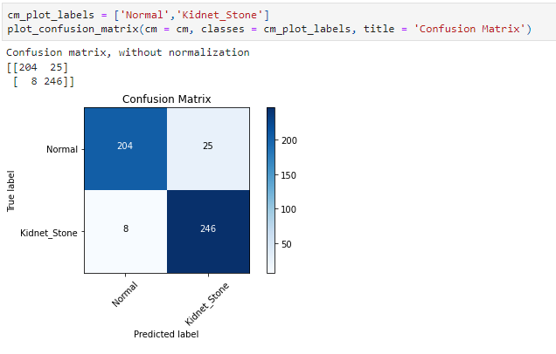

Slide 35
Improvements:
Adopt a better denoising technique and try for more accuracy.
Reduce epochs by better preprocessing.
Compare with other classifiers like k-means, Random forest , other neural network models.
Build confusion matrix for each and compare parrallely.

Slide 36
Conclusion
Image processing techniques play a crucial role in the detection of kidney stones.
By analyzing medical images such as X-rays or CT scans, image processing algorithms can enhance image quality, extract relevant features, and assist in the identification and diagnosis of kidney stones.

